Slide 1

Data Science applications – Clustering Assignment
Submitted By :
Group - DSA_202101_ 12
Lasya Bhaskara (300188682)
Tulika Shukla (300201850)
Xun Xun Shi (7260750)

Slide 2

Problem Statement
We are trying to solve an unsupervised ML problem: to cluster based on the authorship of the book partitions
Books Chosen -
The Man Who Was Thursday - G. K. Chesterton (1908)/ Chesterton-Thursday
Melville – Moby Dick(1851) /Moby-Dick
Stories – E. Bryant (1900-2000) / Bryant-stories
Paradise Lost – John Milton (1667) / Milton-Paradise
Hamlet – William Shakespeare (1609) /Shakespeare-Hamlet
Balanced dataset:
- Take 200 passages with 150 words from each book

Slide 3

The Process
Silhouette, Elbow method,
Dendrograms, Coherence
Pre-process to desired text format
Cluster mistakes
Data
Feature Engineering
Model Comparisons
Evaluate
Error Analysis
Transfer the text to Vectors
Annotated cluster labels
Kappa score

Slide 4
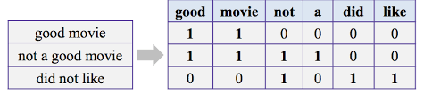
Preprocessing & Feature Engineering
Preprocessing :
Tokenization
Lemmatization
Feature Engineering :
Vectorization is needed to convert our textual data to numerical vectors
We implemented :
TF-IDF
Bag of words (BOW)
Word2Vec
Principal Component Analysis (PCA)

Slide 5
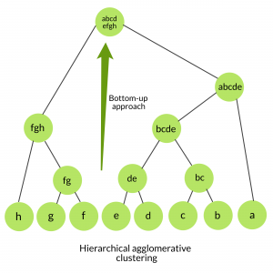
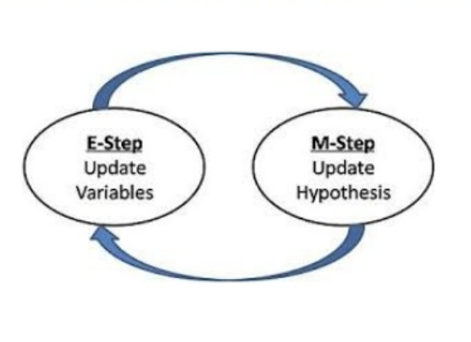
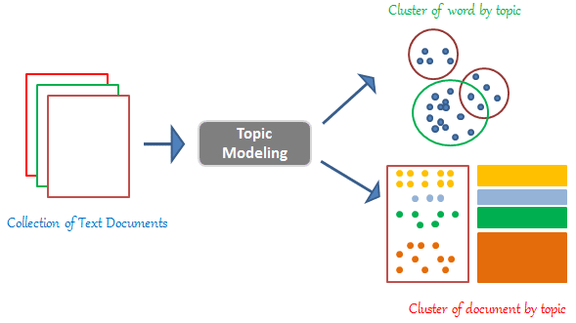
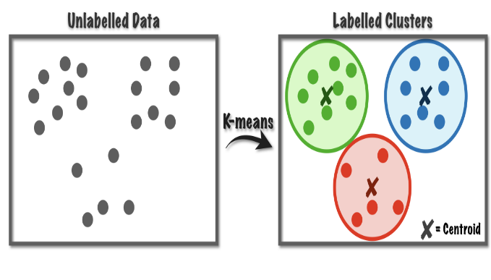
Algorithms Used
K-Means
Hierarchical Agglomerative
Expectation Maximization
Latent Dirichlet Allocation (LDA)
Separates data into clusters of equal variance
Minimizes inertia
Mean of data points within cluster – centroids
Centroids chosen in a way that minimizes inertia.
Agglomerative clustering: bottom - up approach
Building a hierarchy of clusters from data points.
Each data point treated as a cluster and merge repetitively until we are left with one cluster.
GM Model – K number of gaussian distributions with unknown weights
Each distribution assumed as an ellipsoid shaped cluster of varying size, density, orientation etc.,
Iteratively optimizes the cluster weights and assigns data to each cluster.
Draw out topics from a corpus of documents
Analyzing the distributions of topics within each document and proportion of words within a topic.

Slide 6
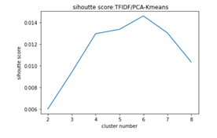
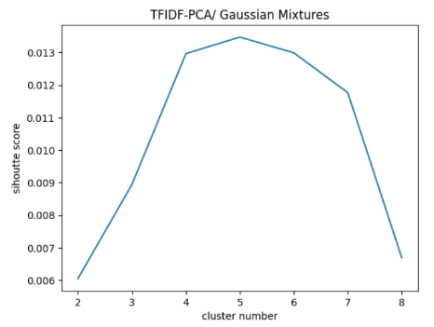
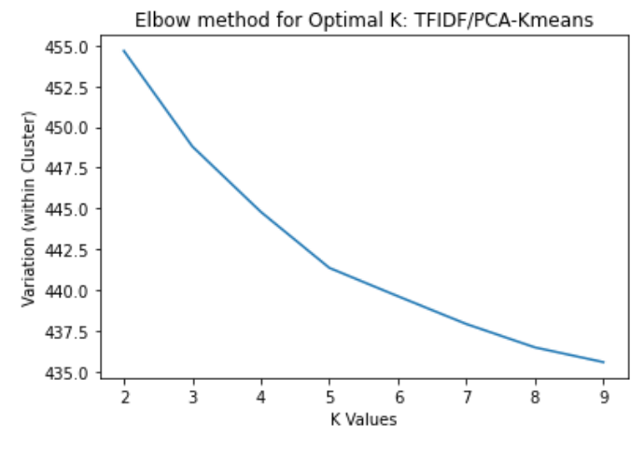
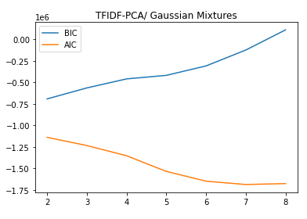
Model Comparison: Effect of Number of Clusters
 | K-Means: TFIDF - PCA | Expectation Maximization: TFIDF - PCA
Silhouette score
Unique Score (Elbow method/ AIC and BIC)

Slide 7
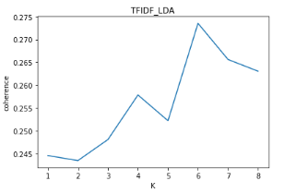
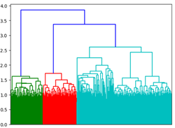
Model Comparison
LDA-TFIDF | Hierarchical Clustering-TFIDF

Slide 8
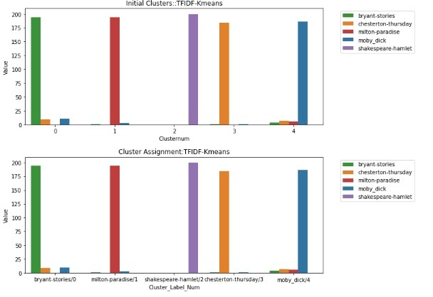
Process of annotating each CLusteR

Slide 9
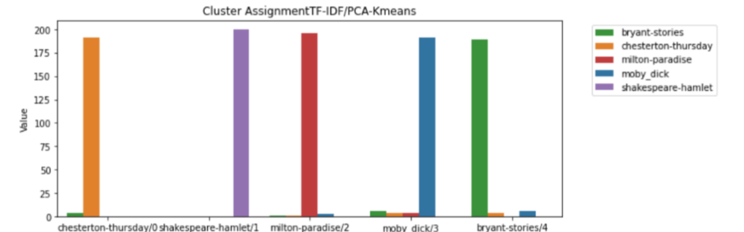
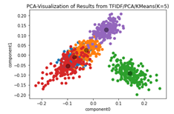
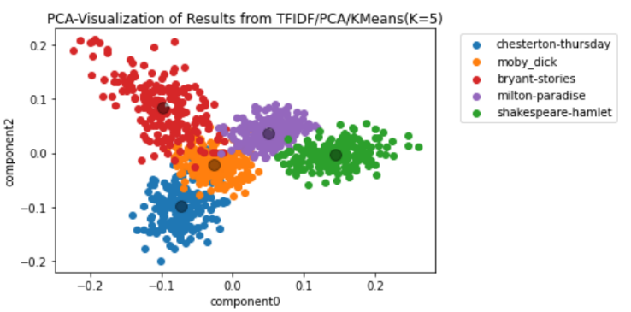
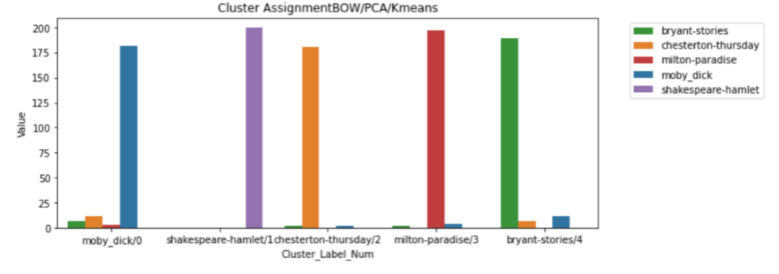
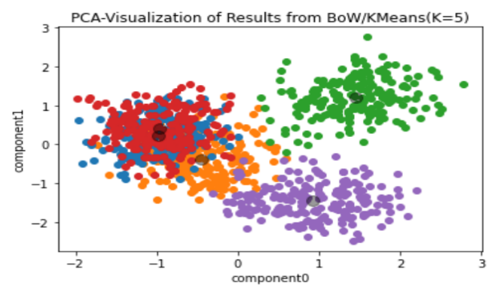
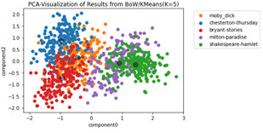
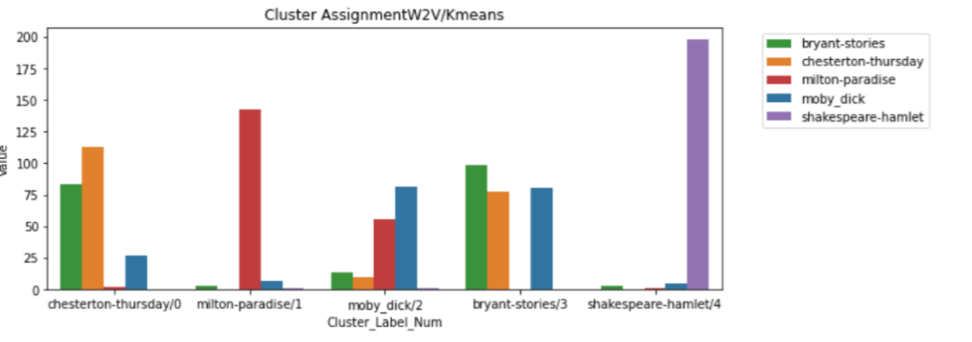
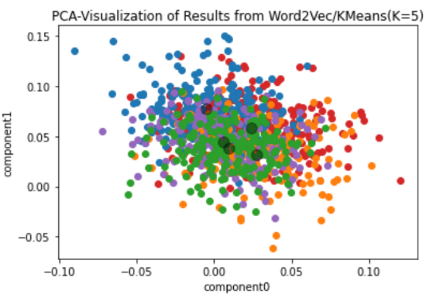
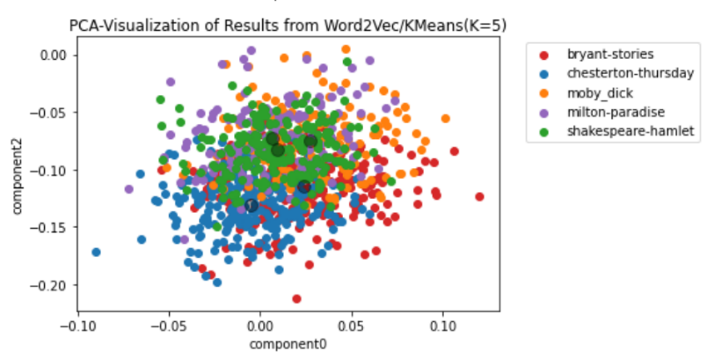
Evaluation of Annotated Clusters and PCA Visualizations with K-Means
 | Annotated clusters | Visualization of different feature components
TF-IDF/PCA
BOW/PCA
Word2Vec

Slide 10
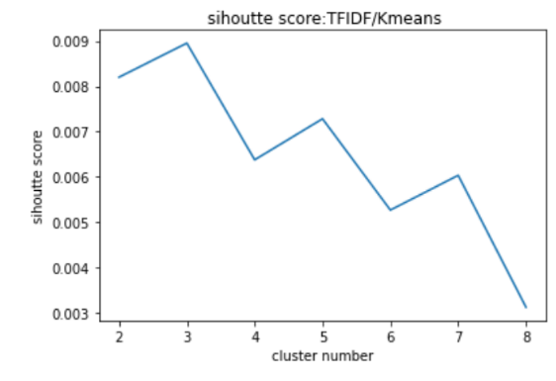
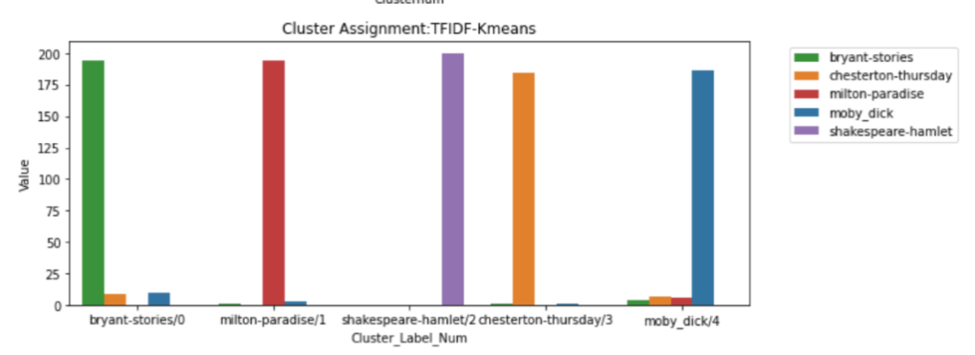
Justification for PCA- K-Means
Kappa Score: 0.9587 Kappa Score: 0.9475

Slide 11
Kappa Score | TF-IDF | TF-IDF + PCA | BOW + PCA | Word 2 Vec
K-means | 0.948 | 0.959 | 0.936 | 0.540
Hierarchical Clustering | N/A | 0.909 | 0.847 | 0.657
Gaussian Mixtures/ EM | N/A | 0.954 | 0.936 | 0.687
Model Evaluation
No. of errors | TF-IDF | TF-IDF + PCA | BOW + PCA | Word 2 Vec
K-means | 42 | 36 | 51 | 368
Hierarchical Clustering | N/A | 73 | 122 | 274
Gaussian Mixtures/ EM | N/A | 37 | 51 | 250

Slide 12
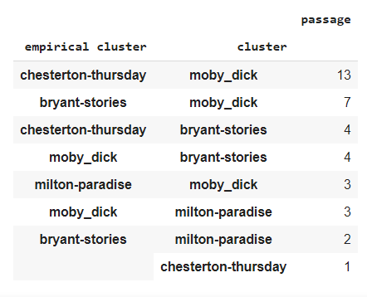
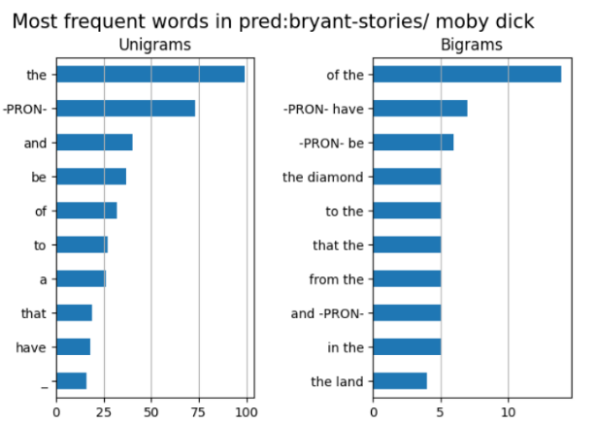
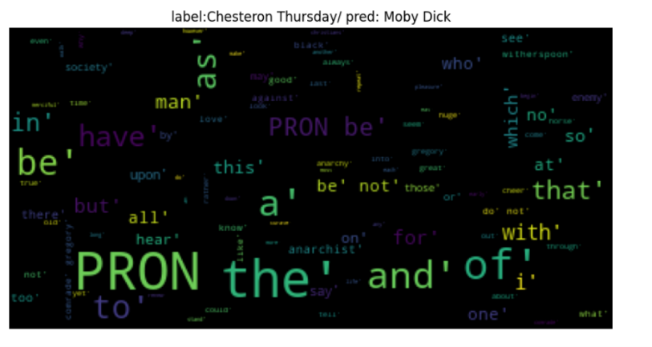
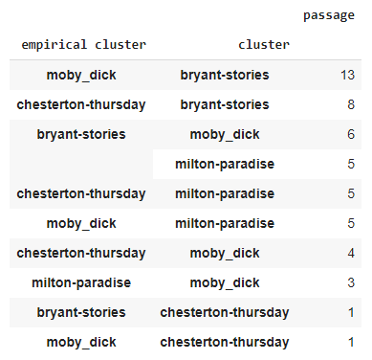
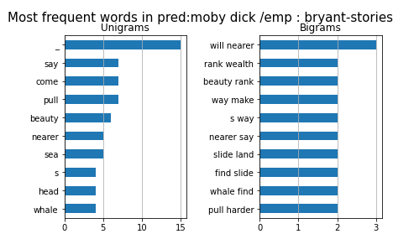
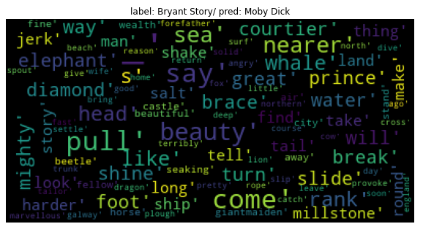
TFIDF/PCA/K-means results: Error Analysis
Before removing stop words: kappa = 0.95
After removing stop words: kappa= 0.93

Slide 13
Conclusion
Tuned and compared 4 different algorithms - 3 feature selections to overcome the challenge of clustering passages from five different books
The optimal combination was K-Means with TF-IDF/PCA. Kappa score of 0.9587
Optimum feature engineering method is TF-IDF with PCA, followed by BOW-PCA, then W2V
EM and K-Means resulted in similar kappa scores, whereas hierarchical clustering resulted in slightly lower kappa scores
Although not removing stop words can include too many non-discriminatory features making it difficult to cluster certain passage, taking out stop words also reduces some important discriminatory features

Slide 14


